Slide 1
Welcome to My Presentation

Slide 2
My Presentation Topic is Control Statements
Presented By:
Name : Tushar Sarkar
Student ID: 18CSE035
Second Year First Semester
Department of CSE,BSMRSTU,
Gopalganj-8100.

Slide 3
Topics
Introduction to control statements.
Types of Control statements.
Decision making Statements.
Loop Statements.
Jump Statements.

Slide 4
Introduction to Control Statements
The statements in the code are executed according in which they appear.
However, Java provides a statements that can be used to control the flow of Java code, such statements are called control flow statements.

Slide 5
Types of Control Flow Statements
Java provides three types of control flow statements:
1.Decision Making Statements.
2.Loop Statements.
3.Jump Statements.

Slide 6
Control Statement
Decision making Statements
Looping Statements
Jump Statements
if else
switch
case
break
continue
while
do while
for

Slide 7
Decision Making Statements
Decision making statements decide which to execute and when.
There are four decision making statements available in Java:
1. If
2.If-else
3.If-else-If or Nested if-else
4.Switch

Slide 8
If Statements
It’s evaluate a Boolean expression and enables the program to enter a block of code if the expression true.
If(condition){
Statement 1 ;
}

Slide 9
If-else Statements
In this statement, if the condition is true then If block execute. Otherwise Else block is execute.
if(condition){
statement 1;
}
else{
statement 2;
}

Slide 10
Nested If-else
It is Chain of If-else statements that create a decision tree where the program may enter in the block basis of condition.
if(condition){
statement 1;
if{
statement 2;
}
else{
statement 3;
}
}

Slide 11
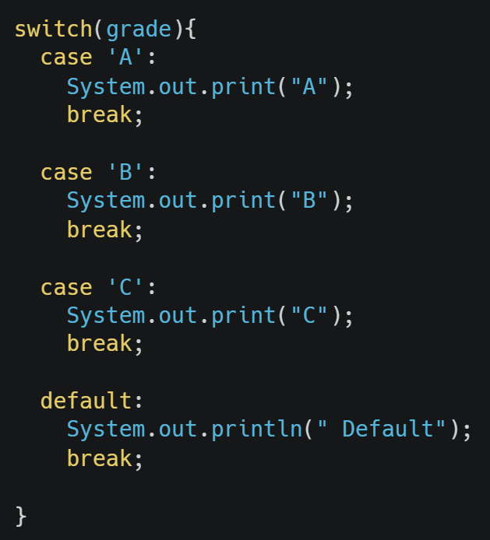
Switch
Switch statement is used to execute a single statement from multiple conditions. It’s similar to If-else-If but easier to use instead of If-else-If.

Slide 12
Loop Statement
These are used to execute a block of statements multiple time. There are three types of loop statements:
1.For loop
2.While loop
3.Do-While loop

Slide 13
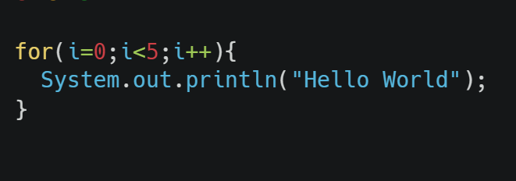
For Loop
It execute the program until condition is false. It is used when number of iteration are known.

Slide 14
While Loop
While evaluates a certain condition. if the condition true, code is execute. This process continued until specified condition turns out to be false.
intitial;
While(condition){
statement ;
increment/decrement;
}

Slide 15
Do-While Loop
In do-while loop it will execute the loop first ,then it check the condition. So it will execute the loop at least once.
initial;
do{
statement ;
statement ;
}
while(condition);

Slide 16
Jump Statements
Jump statements transfer the execution control to the other part of the program. There are two type of Jump statement in Java:
1.Break Statements
2.Continue Statements

Slide 17
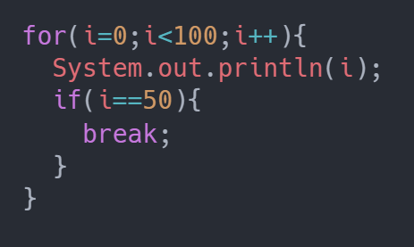
Break Statement
Break statement in Java is used to terminate a loop and break the current flow of program.

Slide 18
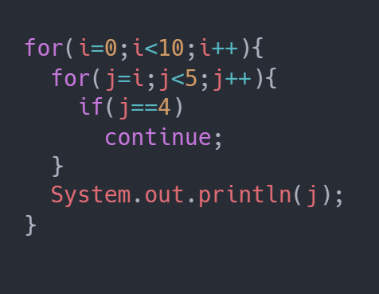
Continue Statement
To jump to the next iteration of the loop, we make use of continue statement

Slide 19


